Slide 1
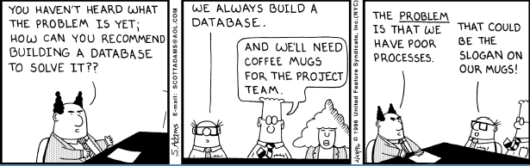
Systems Analysis and Design 10th Edition
Chapter 8 – User Interface Design
Phase 3 Systems Design

Slide 2
Phase Description
Systems design is the third of five phases in the systems development life cycle
Now you will work on a physical design that will meet the specifications described in the system requirements document
Tasks will include user interface design, data design, and system architecture
Deliverable is system design specification

Slide 3
Chapter Objectives
Explain the concept of user interface design and human-computer interaction, including basic principles of user-centered design
Explain how experienced interface designers perform their tasks
Describe rules for successful interface design
Discuss input and output technology issues
Notes:
http://www.nngroup.com/articles/usability-101-introduction-to-usability/

Slide 4
Chapter Objectives (Cont.)
Design effective source documents and forms
Explain printed output guidelines
Describe output and input controls and security
Explain modular design and prototyping techniques

Slide 5
Systems Design Phase Overview
Goal of systems design is to build a system that is effective, reliable, and maintainable
Effective if it supports business requirements and meets user needs
Reliable if it handles input errors, processing errors, hardware failures, or human mistakes
Maintainable if it is flexible, scalable, and easily modified

Slide 6
Systems Design Phase Overview (Cont.)
Will It Succeed?
Think like a user
Carefully examine any point where users provide input or receive output
The user interface must be easy to learn
Input processes should be easy to follow, intuitive, and forgiving of errors
Predesigned output should be attractive and easy to understand, with an appropriate level of detail
Anticipate future needs
Anticipate possible expansion
Provide flexibility
Best design strategy is to offer several alternatives, so users can decide what will work best for them
Start with a default value that displays automatically
Notes:
Know your user!, obsess over customers. Your user’s goals are your goals. Learn everything you can about the user – their level of expertise, skills, experience. Don’t get carried away by trendy design or adding new features. Focus on the user.

Slide 7
10 tips User Design
Know your User
Pay attention to Patterns
Stay Consistent
Use Visual Hierarchy
Provide Feedback
Be Forgiving
Empower Your User
Speak their Language
Keep it Simple
Keep Moving Forward

Slide 8
Know your User!
Obsess over customers.
Your user’s goals are your goals.
Learn everything you can about the user – their level of expertise, skills, experience.
Don’t get carried away by trendy design or adding new features.
Focus on the user.

Slide 9
Pay attention to Patterns
Users spend majority of time on interfaces other than yours
Don’t reinvent the wheel
Those interfaces may solve problems users are having
Use similar UI patterns (User Interface)

Slide 10
Stay Consistent!
Everything has a place and everything in its place
Language, layout, design need to be the same all through
Buttons in same location
Dialog boxes work the same
Users need to know that once they do something they will be able to do it again.
“The more users’ expectations prove right, the more they will feel in control of the system and the more they will like it.” – Jakob Nielson
Notes:
Set standards and stick to them.

Slide 11
Use Visual Hierarchy
Design to allow user to focus on most important thing.
Size, color, placement of an element
Clear Hierarchy reduces complexity
“Designers can create normalcy out of chaos; they can clearly communicate ideas through the organizing and manipulating of words and pictures.” – Jeffery Veen

Slide 12
Provide Feedback
Interface should at all times speak to the user
Communicate right, wrong or misunderstood
Always inform users of actions, changes in state, errors or exceptions that occur
Visual cues or simple messages let user know if actions have led to correct results

Slide 13
Be Forgiving
People make mistakes
Your UI should allow and tolerate user errors
Design ways for user to undo actions
Allow varied inputs (birth date patterns)
If user does cause an error, make it a teaching moment.
Show what was wrong and ensure they know how to do it correctly the next time

Slide 14
Empower your User
Once a user knows the UI, “take off the training wheels”
Breaking down complex tasks helps at beginning but becomes tiresome once know the interface
Allow keyboard shortcuts
Allow quicker ways to get tasks done

Slide 15
Speak their Language
Keep text conversational
Clear, concise labels for actions
Keep messaging simple
“If you think every pixel, every icon, every typeface matters, then you also need to believe every letter matters. ” – Getting Real

Slide 16
Keep it Simple
Best designs are invisible
Don’t include UI-bling or unnecessary elements
Elements should be succinct and make sense
Whenever thinking about adding a new feature or element, ask the question – “Does the user really need this?” or “Why does the user want this very clever animated gif?”
Don’t add features or elements because you want them
“A modern paradox is that it’s simpler to create complex interfaces because it’s so complex to simplify them.” – Pär Almqvist

Slide 17
Keep moving Forward
There will be failures with your UI
But keep moving forward
Keep the UI out of the way of the user.

Slide 18
Systems Design Phase Overview (Cont.)
Manage data effectively
The system should enter and verify data as soon as possible
Each data item should have a specific type, such as alphabetic, numeric, or alphanumeric, and a range of acceptable values
Collect input data as close to its source as possible

Slide 19
Chapter Overview
Users can design their own output
System designers are more aware of user needs and desires. A system can maintain data integrity and still allow users to view, sort, filter, and examine data in any way that helps them do their jobs
Centralized IT departments no longer produce reams of printed reports
Overwhelming trend has been to customer-designed output
The user interface itself has evolved
Most user information needs can be met with screen- generated data, which a user can print, view, or save

Slide 20
What Is a User Interface?
A user interface (UI) describes how users interact with a computer system, and consists of all the hardware, software, screens, menus, functions, output, and features that affect two-way communications between the user and the computer

Slide 21
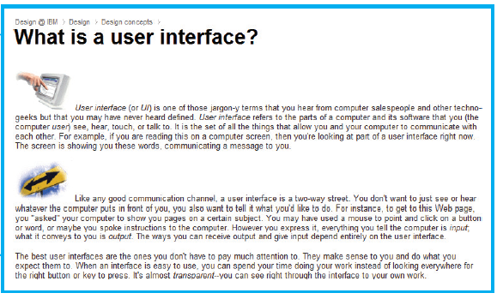
What Is a User Interface?(Cont.)
FIGURE 8-3 According to IBM, the best user interfaces are the ones you don’t really notice

Slide 22
What Is a User Interface?(Cont.)
Human Computer Interaction
Human-computer interaction (HCI) describes the relationship between computers and people who use them to perform their jobs
Graphical user interface (GUI)
Main objective is to create a user-friendly design that is easy to learn and use

Slide 23
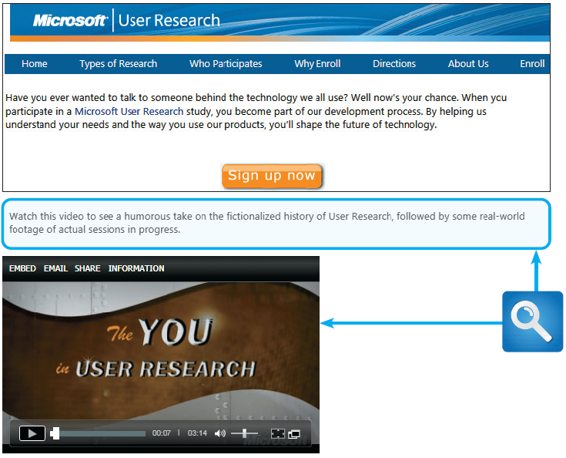
What Is a User Interface?(Cont.)
FIGURE 8-3 According to IBM, the best user interfaces are the ones you don’t really notice

Slide 24
Seven Habits of Successful Interface Designers
Understand the Business
The interface designer must understand the underlying business functions and how the system supports individual, departmental, and enterprise goals
Maximize Graphical Effectiveness
Studies show that people learn better visually
Think Like a User
See the system through a user’s eyes
Use terms and metaphors that are familiar to users
Understand user experience, knowledge, and skill levels

Slide 25
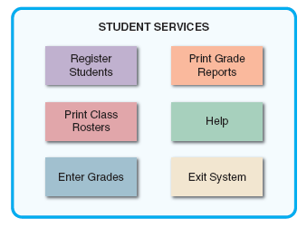
Seven Habits of Successful Interface Designers (Cont.)
4. User Models and Prototypes
Present initial screen designs to users in the form of a storyboard
Users must test all aspects of the interface design and provide feedback to the designers
5. Focus on Usability
Opening screen should show the main options
Offer a reasonable number of choices that a user easily can comprehend
FIGURE 8-7 The opening screen displays the main
options for a student registration system. A user can click
an option to see lower-level actions and menu choices

Slide 26
Seven Habits of Successful Interface Designers (Cont.)
6. Invite Feedback
Monitor system usage and solicit user suggestions
Determine if system features are being used as intended by observing and surveying users
7. Document Everything
Document all screen designs for later use by programmers
Number the screen designs and save them in a hierarchy similar to a menu tree
User-approved sketches and storyboards also can be used to document the user interface

Slide 27
A Handbook for User Interface Design
RULE 1: Create an Interface That Is Easy to Learn and Use
1.1 Focus on system design objectives
1.2 Create a design that is easy to understand and remember
1.3 Provide commands, actions, and system responses that are
consistent and predictable
1.4 Allow users to correct errors easily
1.5 Clearly label all controls, buttons, and icons
1.6 Select familiar images that users can understand, and
provide on-screen instructions that are logical, concise,
and clear
1.7 Show all commands in a list of menu items, but dim any
commands that are not available to the user
1.8 Make it easy to navigate or return to any level in the
menu structure

Slide 28
A Handbook for User Interface Design (Cont.)
RULE 2: Enhance User Productivity
2.1 Organize tasks, commands, and functions in groups that resemble actual business operations
2.2 Create alphabetical menu lists or place the selections used frequently at the top of the menu list
2.3 Provide shortcuts for experienced users so they can avoid multiple menu levels
2.4 Use default values if the majority of values in a field are the same
2.5 Use a duplicate value function that enables users to insert the value from the same field in the previous record, but allow users to turn this feature on or off as they prefer
2.6 Provide a fast-find feature that displays a list of possible values as soon as users enter the first few letters
2.7 If available, consider a natural language feature that allows users to type commands or requests in normal text phrases

Slide 29
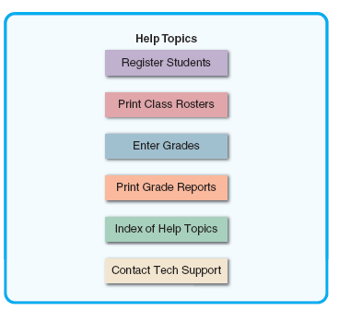
A Handbook for User Interface Design (Cont.)
RULE 3: Provide Users with Help and Feedback
3.1 Ensure that help is always available on demand
3.2 Provide user-selected help and context- sensitive help
3.3 Provide a direct route for users to return to the point from where help was requested
3.4 Include contact information
3.5 Require user confirmation before data deletion (Are you sure?)
3.6 Provide an Undo key 3.7 When a user-entered command contains an error, highlight the erroneous part and allow the user to make the correction without retyping the entire command
FIGURE 8-10 The main Help screen for a student registration system

Slide 30
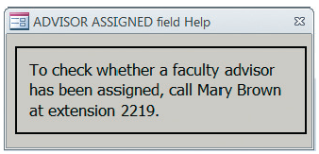
A Handbook for User Interface Design (Cont.)
RULE 3: Provide Users with Help and Feedback (Cont.)
3.8 Use hypertext links to assist users 3.9 Display messages at a logical place
3.10 Alert users to lengthy processing times or delays. Give users an on-screen
progress report
3.11 Allow messages to remain on the screen long enough for users to read them
3.12 Let the user know whether the task or operation was successful or not
3.13 Provide a text explanation if you use an icon or image on a control button
3.14 Use messages that are specific, understandable, and professional Avoid messages that are cute, cryptic, or vague, such as: ERROR — You have entered an unacceptable value
FIGURE 8-11 A context-sensitive dialog box displays if a user requests help while entering data into the ADVISOR ASSIGNED field. Clicking the Close button returns the user to the task

Slide 31
A Handbook for User Interface Design (Cont.)
RULE 4: Create an Attractive Layout and Design
4.1 Use appropriate colors to highlight different areas of the screen; avoid gaudy and bright colors
4.2 Use special effects sparingly
4.3 Use hyperlinks that allow users to navigate to related topics
4.4 Group related objects and information. Visualize the screen the way a user will see it, and simulate the tasks that the user will perform
4.5 Keep screen displays uncluttered, with enough white space to create an attractive, readable design
4.6 Display titles, messages, and instructions in a consistent manner and in the same general locations on all screens
4.7 Use consistent terminology
4.8 Ensure that commands always will have the same effect

Slide 32
A Handbook for User Interface Design (Cont.)
RULE 4: Create an Attractive Layout and Design (Cont.)
4.9 Ensure that similar mouse actions will produce the same results
4.10 Require the user to confirm the entry by pressing Enter or Tab
4.11 Remember that users are accustomed to a pattern of red = stop, yellow = caution, and green = go
4.12 Provide a keystroke alternative for each menu command, with easy-to-remember letters, such as File, Exit, and Help 4.13 Use familiar commands if possible, such as Cut, Copy, and Paste
4.14 Provide a Windows look and feel in your interface design if users are familiar with Windows-based applications
4.15 Avoid complex terms and technical jargon

Slide 33
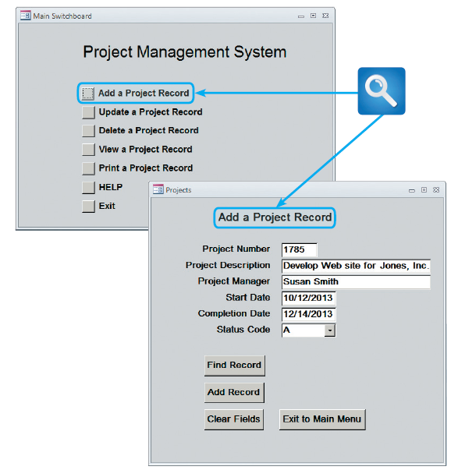
A Handbook for User Interface Design (Cont.)
RULE 5: Enhance the Interface
5.1 The opening screen is especially important because it introduces the application
The starting point can be a switchboard with well- placed command buttons that allow users to navigate
the system
FIGURE 8-12 An example of a switchboard and data entry screen for a project management system

Slide 34
A Handbook for User Interface Design (Cont.)
RULE 5: Enhance the Interface (Cont.)
5.2 Use a command button to initiate an action such as printing a form or requesting help
5.3 If you are using a software package, check to see if it allows you to create customized menu bars and toolbars
5.4 Add a shortcut feature that lets a user select a menu command either by clicking the desired choice or by pressing the Alt key + the underlined letter
5.5 If variable input data is needed, provide a dialog box that explains what is required
5.6 A toggle button makes it easy to show on or off status — clicking the toggle button switches to the other state
5.7 Use list boxes that display the available choices
5.8 Use an option button, or radio button, to control user choices

Slide 35
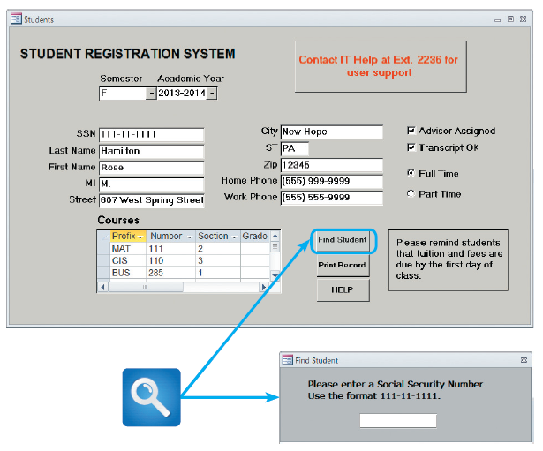
A Handbook for User Interface Design (Cont.)
RULE 5: Enhance the Interface (Cont.)
5.9 If you use check boxes to select one or more choices from a group, show the choices with a checkmark or an X
5.10 When dates must be entered, use a calendar control that allows the user to select a date that the system will use as a field value
FIGURE 8-13 A data entry screen for the student registration system. This screen uses several design features that are described in the text. When a user clicks the Find Student command button, a dialog box is displayed with instructions

Slide 36
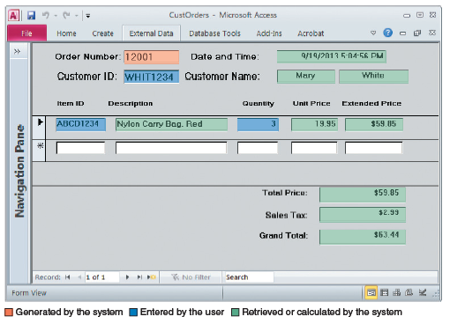
A Handbook for User Interface Design (Cont.)
RULE 6: Focus on Data Entry Screens
6.1 Whenever possible, use a data entry method called form filling, where a blank form that duplicates the source document is completed
on screen
6.2 Position the insertion point in the first data entry location
6.3 Provide a way to leave the data entry screen at any time without entering the current record
6.4 Provide a descriptive caption for every field
FIGURE 8-14 In this data screen for customer orders, the system generates an order number and logs the
current date and time. The user enters a customer ID. If the entry is valid, the system displays the customer
name so the user can verify it. The user then enters the item and quantity. Note that the description, price,
extended price, total price, sales tax, and grand total are retrieved automatically or calculated by the system

Slide 37
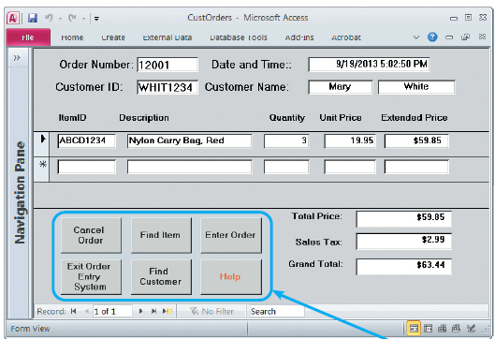
A Handbook for User Interface Design (Cont.)
RULE 6: Focus on Data Entry Screens (Cont.)
6.5 Provide a means for users to move among fields on the form in a standard order or in any order they choose
6.6 Allow users to add, change, delete, and view records
6.7 Design the screen form layout to match the layout of the source document
6.8 Display a sample format like MMDDYY, and provide separators, such as slashes
6.9 Use an input mask
FIGURE 8-15 This is an enhanced version of the data entry screen shown in Figure 8-14. The new version
has command buttons that allow the user to perform various functions

Slide 38
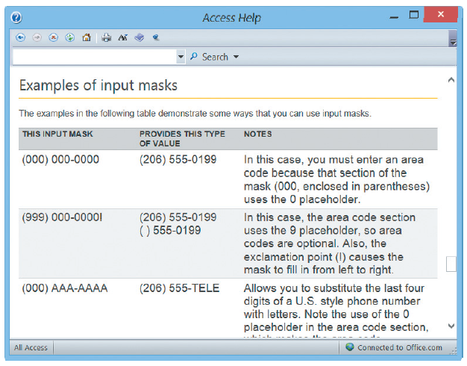
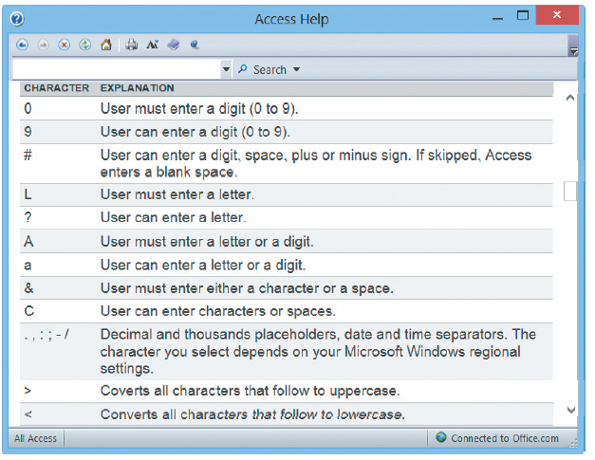
A Handbook for User Interface Design (Cont.)
FIGURE 8-16 Microsoft Access 2010 provides various input masks for dates, phone numbers, and postal codes, among others. In addition, it is easy to create a custom mask using the characters shown here

Slide 39
A Handbook for User Interface Design (Cont.)
RULE 6: Focus on Data Entry Screens (Cont.)
6.10 Require an ending keystroke for every field
6.11 Do not require users to type leading zeroes for numeric fields
6.12 Do not require users to type trailing zeroes for numbers that include decimals
6.13 Display default values so operators can press the Enter key to accept the suggested value
6.14 Use a default value when a field value will be constant for successive records or throughout the data entry session
6.15 Display a list of acceptable values for fields, and provide meaningful error messages if the user enters an unacceptable value
6.16 Provide users with an opportunity to confirm the accuracy of input data before entering it by displaying a message such as, Add this record? (Y/N)

Slide 40
A Handbook for User Interface Design (Cont.)
RULE 7: Use Validation Rules
7.1 A sequence check can be used when the data must be in some predetermined sequence
7.2 An existence check can apply to mandatory data items
7.3 A data type check can test to ensure that a data item fits the required data type
7.4 A range check can be used to verify that data items fall between a specified minimum and maximum value
7.5 A reasonableness check identifies values that are questionable, but not necessarily wrong
7.6 A validity check can be used for data items that must have certain values
7.7 A combination check is performed on two or more fields to ensure that they are consistent or reasonable when considered together
7.8 Batch controls are totals used to verify batch input

Slide 41
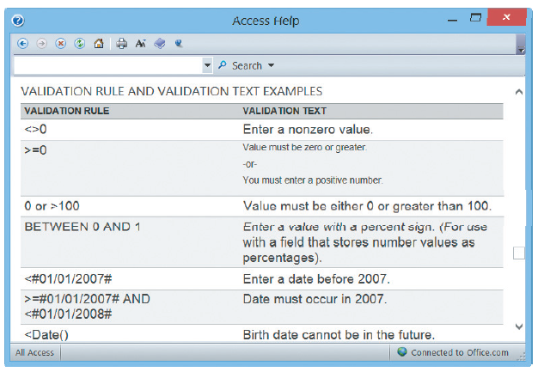
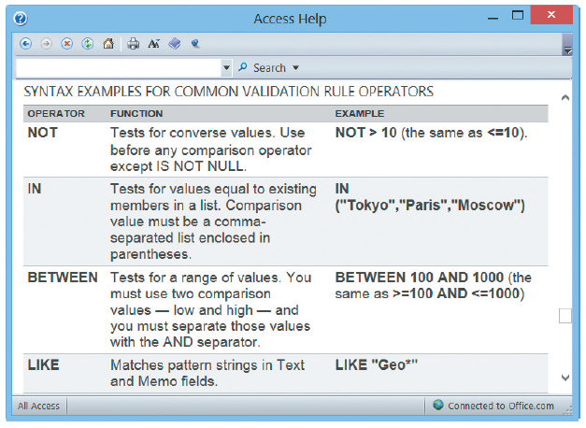
A Handbook for User Interface Design (Cont.)
FIGURE 8-17 Validation rules can improve data quality by requiring the input to meet specific
requirements or conditions

Slide 42
A Handbook for User Interface Design (Cont.)
RULE 8: Reduce Input Volume
8.1 Input necessary data only
8.2 Do not input data that the user can retrieve from system files or calculate from other data
8.3 Do not input constant data
8.4 Use codes. Codes are shorter than the data they represent, and coded input can reduce data entry time

Slide 43
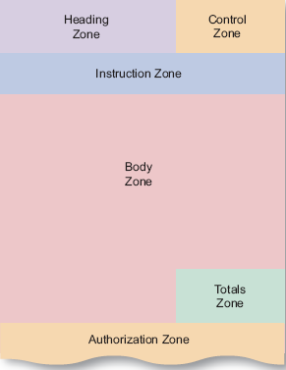
Source Document and Form Design
Good form layout makes the form easy to complete and provides enough space, both vertically and horizontally, for users to enter the data
Information should flow on a form from left to right and top to bottom
The order and placement of fields should be logical, and totals should be identified clearly
FIGURE 8-18 Source document zones

Slide 44
Printed Output
Before designing printed output, ask yourself several questions:
Why is this being delivered as printed output, rather than screen-based information, with an option for users to view, print, or save as needed?
Who wants the information, why is it needed, and how will it be used?
What specific information will be included?
Will the printed output be designed for a specific device?
When and how will the information be delivered, and how often must it be updated?
Do security or confidentiality issues exist? How will they be managed?

Slide 45
Printed Output (Cont.)
Overview of Report Design
Organizations strive to reduce the flow of paper and printed reports, but few firms have been able to eliminate printed output totally
Users find it handy to view screen output, then print the information they need for a discussion or business meeting
Reports must be easy to read and well organized
Database programs such as Microsoft Access include a variety of report design tools, including a Report Wizard, which is a menu-driven feature that designers can use to create reports quickly and easily

Slide 46
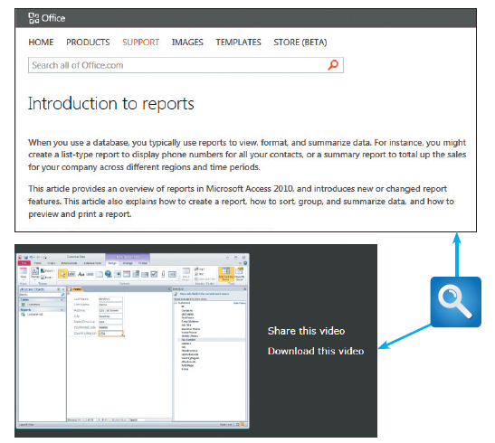
Printed Output (Cont.)
FIGURE 8-19 Microsoft offers suggestions, tips, and a video that can help you design better forms and reports

Slide 47
Printed Output (Cont.)
Types of Reports
DETAIL REPORTS
Produces one or more lines of output for each record processed
Can be quite lengthy
A better alternative might be an exception report
EXCEPTION REPORTS
Displays only those records that meet a specific condition or conditions
Useful when the user wants information only on records that might require action, but does not need to know the details
SUMMARY REPORTS
Upper-level managers often want to see total figures and do not need supporting details

Slide 48
Printed Output (Cont.)
User Involvement
Report Design Principles
Must be attractive, professional, and easy to read
Should provide totals and subtotals for numeric fields
Analyst must consider design features such as report headers and footers, page headers and footers, column headings and alignment, column spacing, field order, and grouping of detail lines
Report Headers and Footers
Every report should have a report header and a report footer
Header identifies the report, and contains the report title, date, and other necessary information
Footer can include grand totals for numeric fields and other end-of-report information

Slide 49
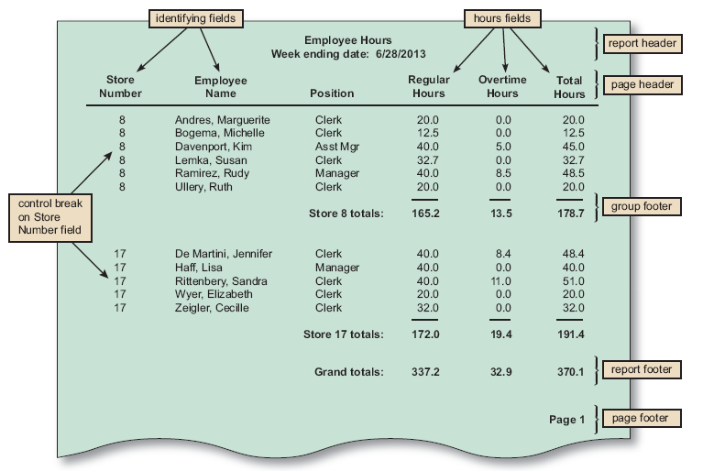
Printed Output (Cont.)
FIGURE 8-20 The Employee Hours report is a detail report with control breaks, subtotals, and grand totals. Notice that a report header identifies the report, a page header contains column headings, a group footer contains subtotals for each store, a report footer contains grand totals, and a page footer identifies the page number

Slide 50
Printed Output (Cont.)
Report Design Principles (Cont.)
Page Headers and Footers
Every page should have a report header and a report footer
Header includes the column headings that identify the data. The headings should be short but descriptive
Footer used to display the report title and the page number
Repeating Fields
The best advice is to ask users what they think and be guided accordingly
Consistent Design
Look and feel are important to users, so reports should be uniform and consistent

Slide 51
Technology Issues
Output Technology
In addition to screen output and printed matter, output can be delivered in many ways
Create the actual forms, reports, documents, and other types of output that might be accessed from workstations, notebooks, tablets, smartphones, and other devices
Internet-based information delivery
Web-based delivery allows users to download a universe of files and documents to support their information needs

Slide 52
Technology Issues (Cont.)
Output Technology (Cont.)
E-mail
An essential means of internal and external business communication
Blogs
Useful for posting news, reviewing current events, and promoting products
Instant messaging
Useful as a constant flow of communication, especially as a team member in a collaborative situation

Slide 53
Technology Issues (Cont.)
Output Technology (Cont.)
Wireless devices
Transmitted to a wide array of mobile devices, including tablet computers, smartphones, and similar wireless products that combine portable computing power, multimedia capability, and Internet access
Digital audio, images and video
Sounds, images, and video clips can be captured, stored in digital format
Can be attached to an e-mail message or inserted as a clip in a Microsoft Word document

Slide 54
Technology Issues (Cont.)
Output Technology (Cont.)
Podcasts
Firms use podcasts as sales and marketing tools, and to communicate with their own employees
Automated facsimile systems
Faxback system allows a customer to request a fax using e-mail, via the company Web site, or by telephone
Computer output to microfilm (COM)
Output to microfilm (COM) is often used by large firms to scan and store images of original documents to provide high-quality records management and archiving

Slide 55
Technology Issues (Cont.)
Output Technology (Cont.)
Computer output to digital media
Digital storage media can include magnetic tape, CDs, DVDs, and high-density laser disks
Used when many paper documents must be scanned , stored in digital format and retrieved quickly
Specialized Forms of Output
Portable, Web-connected devices that can run multiple apps
Retail point-of-sale terminals that handle credit card transactions
Automatic teller machines (ATMs) that can process bank transactions
Special-purpose printers that can produce labels, employee ID cards, driver’s licenses, gasoline pump receipts, and, in some states, lottery tickets
Plotters that can produce high-quality images such as blueprints, maps, and electronic circuit diagrams
Electronic detection of data embedded in credit cards, bank cards, and employee identification cards

Slide 56
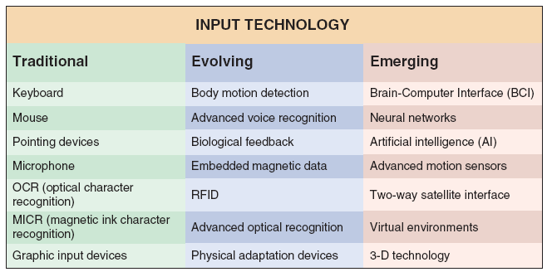
Technology Issues (Cont.)
FIGURE 8-22 Input devices can be very traditional, or based on the latest technology

Slide 57
Technology Issues (Cont.)
Input Technology
Batch Input
Data entry usually is performed on a specified time schedule, such as daily, weekly, monthly, or longer
Online Input
A popular online input method is source data automation, which combines online data entry and automated data capture using input devices such as RFID tags or magnetic data strips
Source data automation is fast and accurate, and minimizes human involvement in the translation process

Slide 58
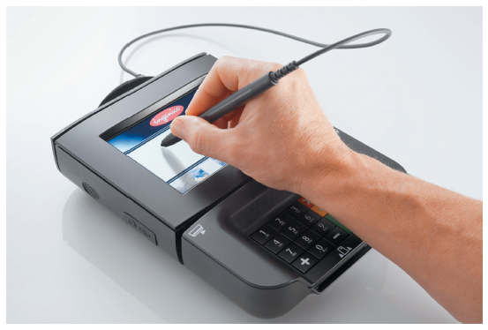
Technology Issues (Cont.)
Input Technology (Cont.)
Businesses use point-of-sale (POS) terminals equipped with bar code scanners and magnetic swipe scanners to input credit card data
Automatic teller machines (ATMs) read data strips on bank cards
Factory employees use magnetic ID cards to clock on and off specific jobs
Hospitals imprint bar codes on patient identification bracelets and use portable scanners when gathering data on patient treatment and medication
FIGURE 8-23 When a customer’s signature is stored in digital form, it becomes input to the information system

Slide 59
Technology Issues (Cont.)
Input Technology (Cont.)
Retail stores use portable bar code scanners to log new shipments and update inventory data
Libraries use handheld scanners to read optical strips on books
Trade Offs
Manual data entry is slower and more expensive than batch input because it is performed at the time the transaction occurs and often done when computer demand is at its highest

Slide 60
Security and Control Issues
Output Security and Control
Output must be accurate, complete, current, and secure
Output security protects privacy rights and shields the organization’s proprietary data from theft or unauthorized access
Use specific procedures to ensure that the output is delivered to authorized recipients only
Shred sensitive reports, out-of-date reports, and output from aborted print runs

Slide 61
Security and Control Issues (Cont.)
Input Security and Control
Input must be correct, complete, and secure
Every piece of information should be traceable back to the input data that produced it
Procedures needed for handling source documents to ensure that data is not lost before it enters the system
Audit trail files and reports should be stored and saved

Slide 62
Where Do We Go From Here
Modular Design
Create individual components, called modules, which connect to a higher-level program or process
Use a structured design so each module represents a specific process, which is shown on a DFD and documented in a process description
Prototyping
A repetitive sequence of analysis, design, modeling, and testing, is a common technique that can be used to design anything from a new home to a computer network

Slide 63
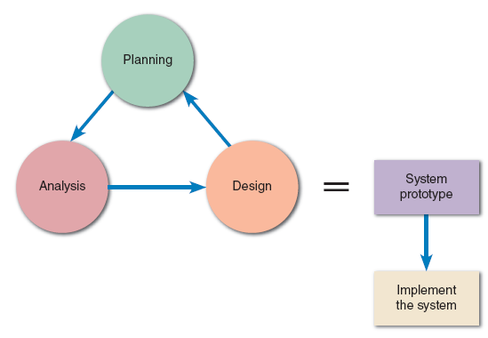
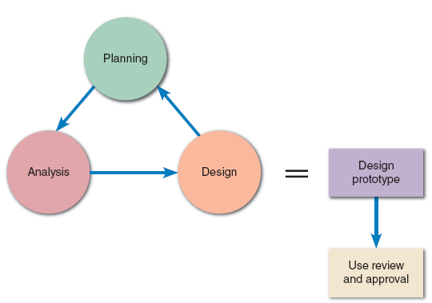
Where Do We Go From Here (Cont.)
System Prototyping
Produces a full-featured, working model of the information system
Design Prototyping
Verify user requirements, after which the prototype is discarded and implementation continues
FIGURE 8-26 The end product of system prototyping is a working model of the information system, ready for implementation
FIGURE 8-27 The end product of design prototyping is a user-approved model that documents and benchmarks the features of the finished system

Slide 64
Where Do We Go From Here (Cont.)
Trade-Offs
Input must be correct, complete, and Users and systems developers can avoid misunderstandings
System developers can create accurate specifications for the finished system based on the prototype
Managers can evaluate a working model more effectively than a paper specification
Systems analysts can use a prototype to develop testing and training procedures before the finished system is available
Prototyping reduces the risk and potential financial exposure that occur when a finished system fails to support business needs
Potential Problems:
The rapid pace of development can create quality problems, which are not discovered until the finished system is operational
Other system requirements, such as reliability and maintainability cannot be tested adequately using a prototype
In very complex systems, the prototype can become unwieldy and difficult to manage

Slide 65
Chapter Summary
The purpose of systems design is to create a physical model of the system that satisfies the design requirements that were defined during the systems analysis phase
Create a transparent interface:
Easy to learn and use
Enhance user productivity
Make it easy to obtain help or correct errors
Minimize input data problems
Provide feedback
Create an attractive layout and design
Use familiar terms and images

Slide 66
Chapter Summary (Cont.)
Printed reports, include detail, exception, and summary reports
There are various zones in a document, including the heading zone, the control zone, the instruction zone, the body zone, the totals zone, and the authorization zone
Input methods include batch and online
There are different Input media and procedures
Security and control plays an important role

